Slide 1
ATS Notepad Updates
Dailyn Barahona López
ATS AMS A4 & Multivendor Print GEN Engineer

Slide 2

Project Charter | ATS Notepad
Problem Statement
Project Stakeholders
At the time to get data from CDAX, the information is very disorganized and sometimes useless, this causes extra work doing deep dives and cleaning the data before being able to read it and finding the required information.
This happens from the fact that there is no standardization in the tittles and notes taking.
Sponsor(s)
Jennifer Chavarria
Project Manager
Dailyn Barahona Lopez
Strategic Partner(s):
Pablo Bustamante
Walter Chacon
Korinna Guillinta
Extended Partner(s):
Fernando Panameno
Solution
Implementation of a case data consistency program to take notes and tittles, with a friendly interface, sightly and easy to use, to standardize the case documentation and tittle creation, reducing the time in aux, becoming the process more efficient, improving the data collection for reports and accelerating the process training with the training of the new hires.
X to Y by Z
Minimize the usage to other tools from 3 to 1
Reduce the number of root cause categories in 58% and the number of fix categories in 74%
Getting 90% usable data from CDAX reports
High-Level Project Timeline
Metrics/Goal
Getting get 90% usable data from tasks and 8D CDAX
Q1´22 |  |  | Q2´22 |  |  | Q3´22 |  |  | Q4´22 |  |  | Q1´23
Nov | Dec | Jan | Feb | Mar | Apr | May | Jun | Jul | Aug | Sep | Oct | Nov | Dec | Jan
Elaboration of the app
Implementation and feedback. A4
Analysis of the data & web-based creation
Mapping to ATS Priorities
Implementation and feedback. A3 & PP.
CAE | Operational Excellence | Scale Technical Knowledge | People

Slide 3

What have been done?
Implementation
Root cause, prevent and fix entries reduction
Clearer reports
Request 8D integrated in CDAX

Slide 4
Data comparison

Slide 5
Prevent

Slide 6
Unified CRM
Flexible agent Workspace

Slide 7
Unified CRM strategic lines
One working space, one set of information
Unified real time access
Improved Case profiling
Integrated Elevation/Escalation workflow
One single tool to receive/manage:
Consultations
Direct2ATS (client/partner)
Automated case creation from:
Chat, Phone, Forums, or Email
Solution alignment with our Support partners (CCC, Field delivery and Channel partners)
Expand information with Root cause analysis (8D) and customer profile (sentiment, history, etc)
Avoid manual re-entry of data by automatic available data loading
CDAX – SI connectivity
Elevation mgmt in one single tool across ATS, including TPM elevations
Include BEM workflow

Slide 8
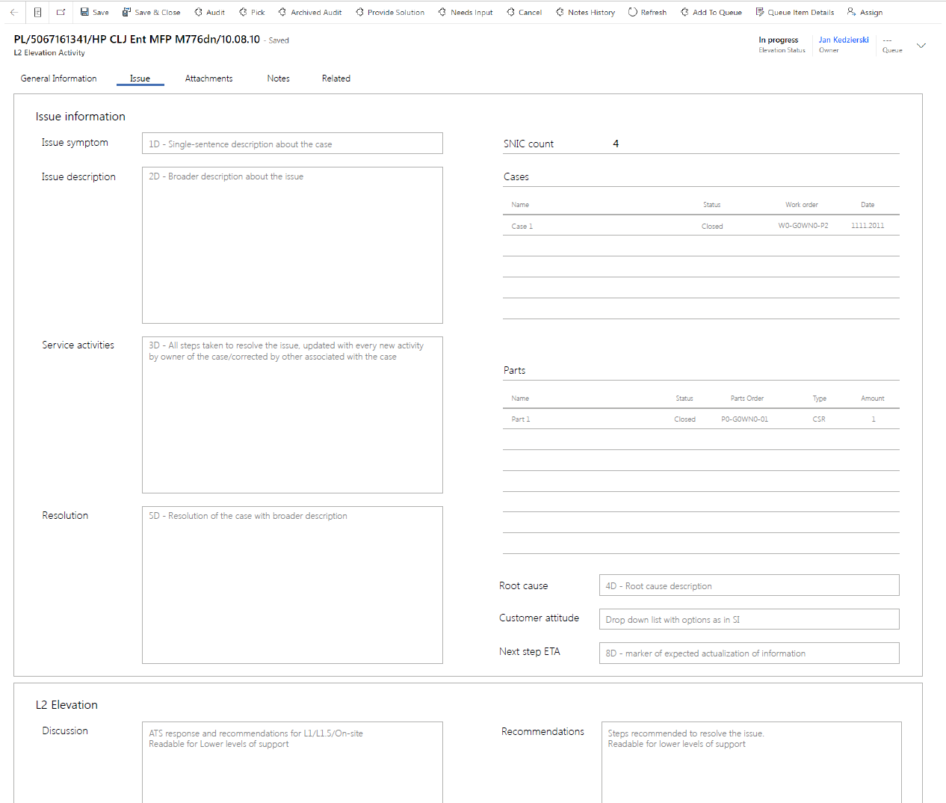
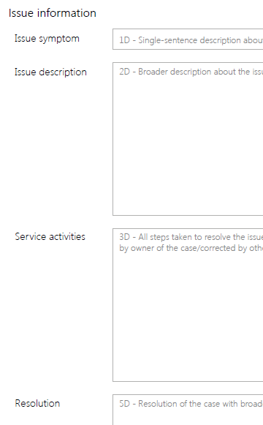
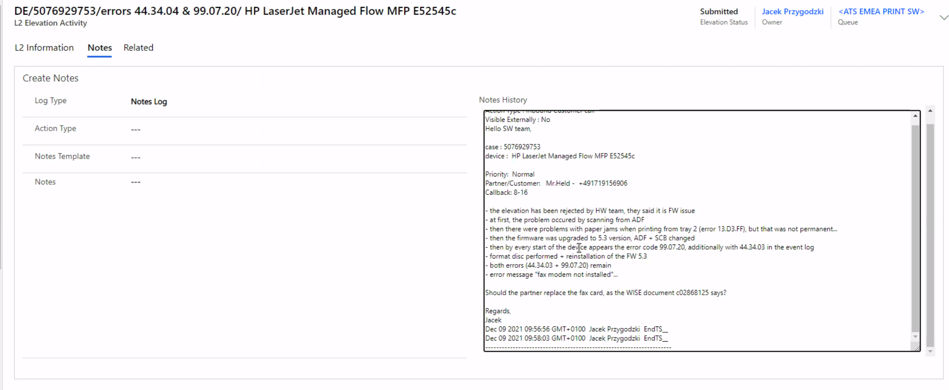
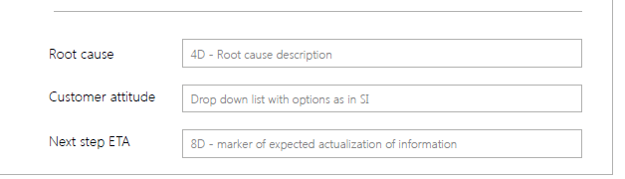
Improve case data
Pilot
New fields
Deployment
New design Deployment
A long roadmap that includes 8D and case profile advancements
Support for 8D root cause analisis
Composed of 4-8 new fields
Case profile advancements
Fields Complexity/Severity/Sentiment
Activate 8D fields through a text template among the other elevation activity templates
New fields to be moved from the template to the form
Tabs and fields re-design

Slide 9
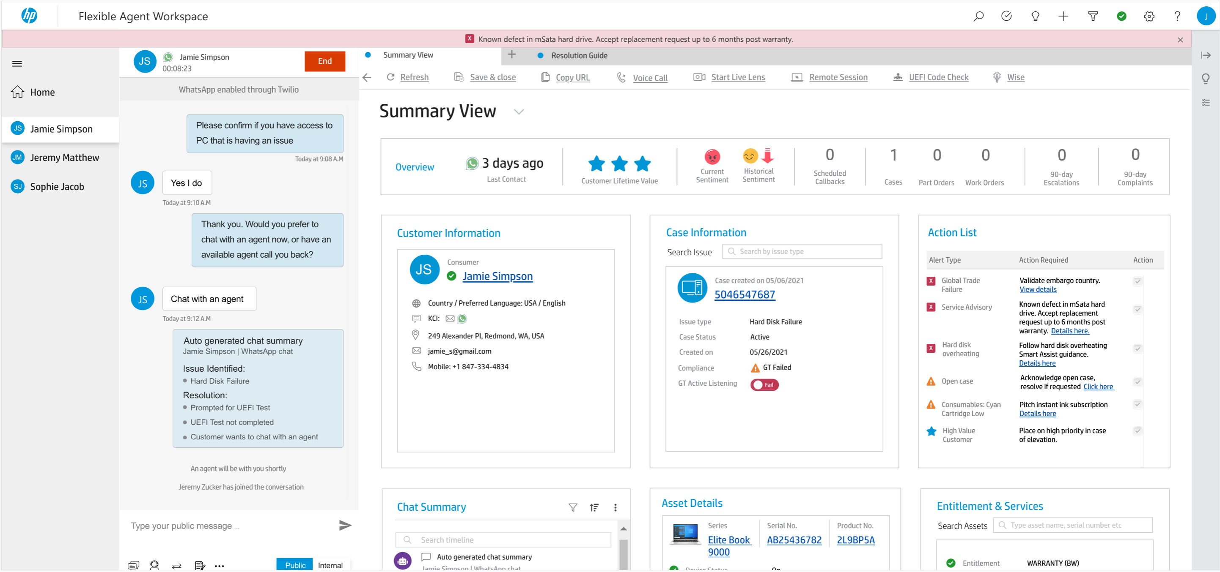
FLEXIBLE AGENT Workspace
Delivering powerful integrated features for agents …
Instant Customer Overview
Account value / customer value, interaction history and sentiment
Action List
Prioritize list of alters and actions with guidance to drive resolution
Workspace will dynamically optimize for agent profiles:
AI Powered Knowledge Article Recommendation
(Smart Assist)
Provide contextual information to agent – troubleshooting guides, service alerts
Gig-Agent
L1 Agent
L2 Agent
Complaints
ATS
Communication channel agnostic
Same behavior, same content
Resolution Guides (PrediFix)
Simplified, step-by-step guidance on troubleshooting with automatic notes capture
UI Simplification
Reduce information overload and align UI to agent workflow
Automation Macros
Trigger Part Order or Work Order automation using case information available
Auto Information capture
Capture information from virtual assistant and through live embedded forms
Direct Device Telemetry Access
Overview of customer asset with details on component level alerts to aid quick diagnosis of issues
Building upon the MSFT Dynamics Platform:
CDAX remains foundation
Utilizes new Omnichannel functionality

Slide 10
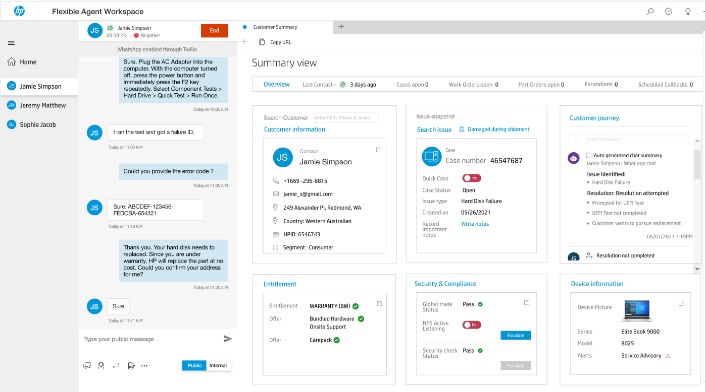
Prototype for Flexible Agent Workspace design based on six scenarios
Scenarios designed to maximize coverage of Case workflow
# | Segment | Profile | Product Category | Issue | Experience/Process Showcased |  |  | Link to Mockup
1 | Consumer | Traditional Agent | PC | Hard Disk Failure | Troubleshooting | Part Order Macro | Address Update
2 | Consumer | Traditional Agent | Print | Connectivity Issue | Troubleshooting | Elevation | Remote Control
3 | Commercial | Traditional Agent | Print | Paper Jam | Live Lens | On-site Support Work Order | Asset Location
4 | Consumer | Traditional Agent | Print | Instant Ink | Cartridge Order | Subscription Change | Self-Service Guidance
5 | Consumer | Gig Agent | PC | Hard Disk Failure | Troubleshooting | Part Order Macro | Address Update
6 | Consumer | Supervisor | All | Reporting Dashboard | Analyze Team and Individual Metrics | View Cases that Require Attention | Execute Call Backs, Transfers or Rescheduled
Out of scope:
Search Page
Part Order, Material Order
Work Order and dispatch

Slide 11
Thank you

